Slide 1

5 Steps to Boosting Resilience
Welcome
Michelle Fitzsimons
Peter O’Hare
Notes:
Intro Janie
Resilience – why we need it
Resilience – learnable skill
We choose the life we live
Proactive

Slide 2

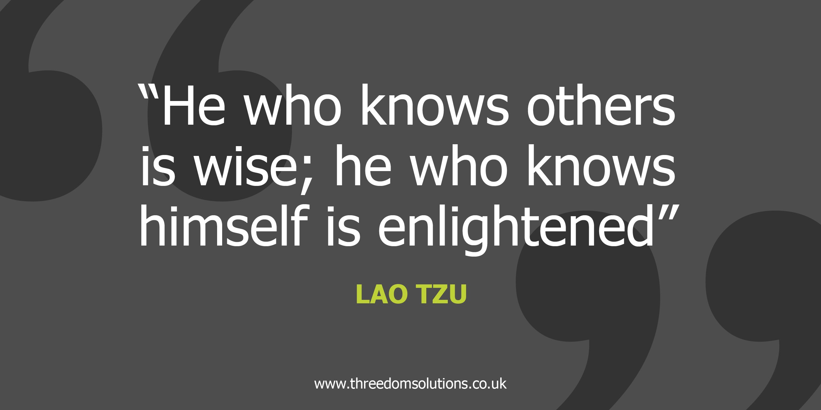
Step 1 – Know yourself

Slide 3

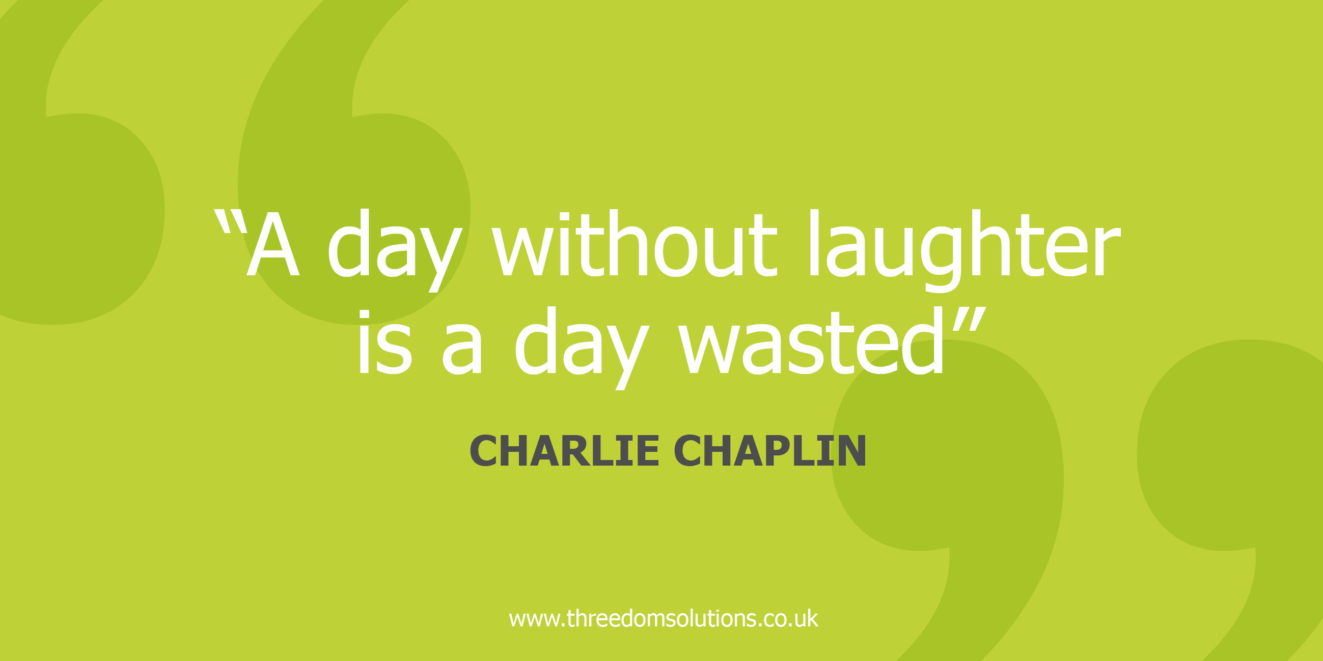
Step 2 – LOL

Slide 4
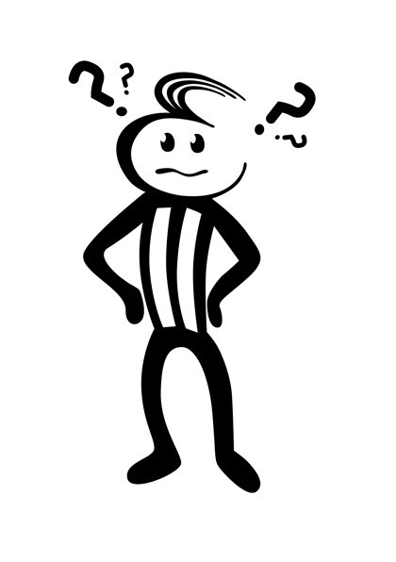
Step 3 – Thinking Traps
Tunnel Vision
Jumping to conclusions
Mind Reading
Black and White
Maximising/Minimising
Shoulda, Woulda,Coulda,
Personalisation
Externalising
Over-generalisation
Emotional Reasoning

Slide 5
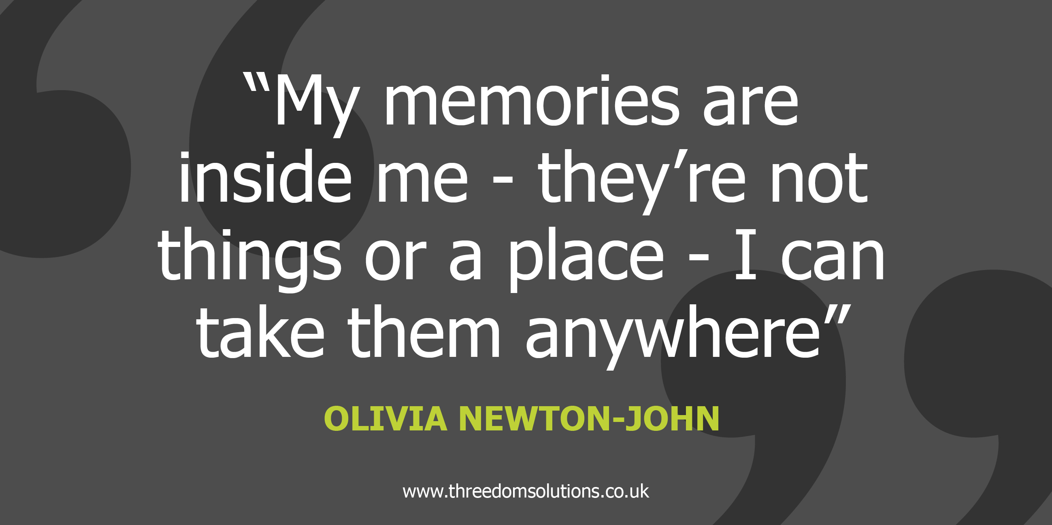

Step 4 – Anchors
Notes:
What is an anchor
How relate to building resilience
Examples
Use natural ones and create new ones
Challenge – find one and use it

Slide 6

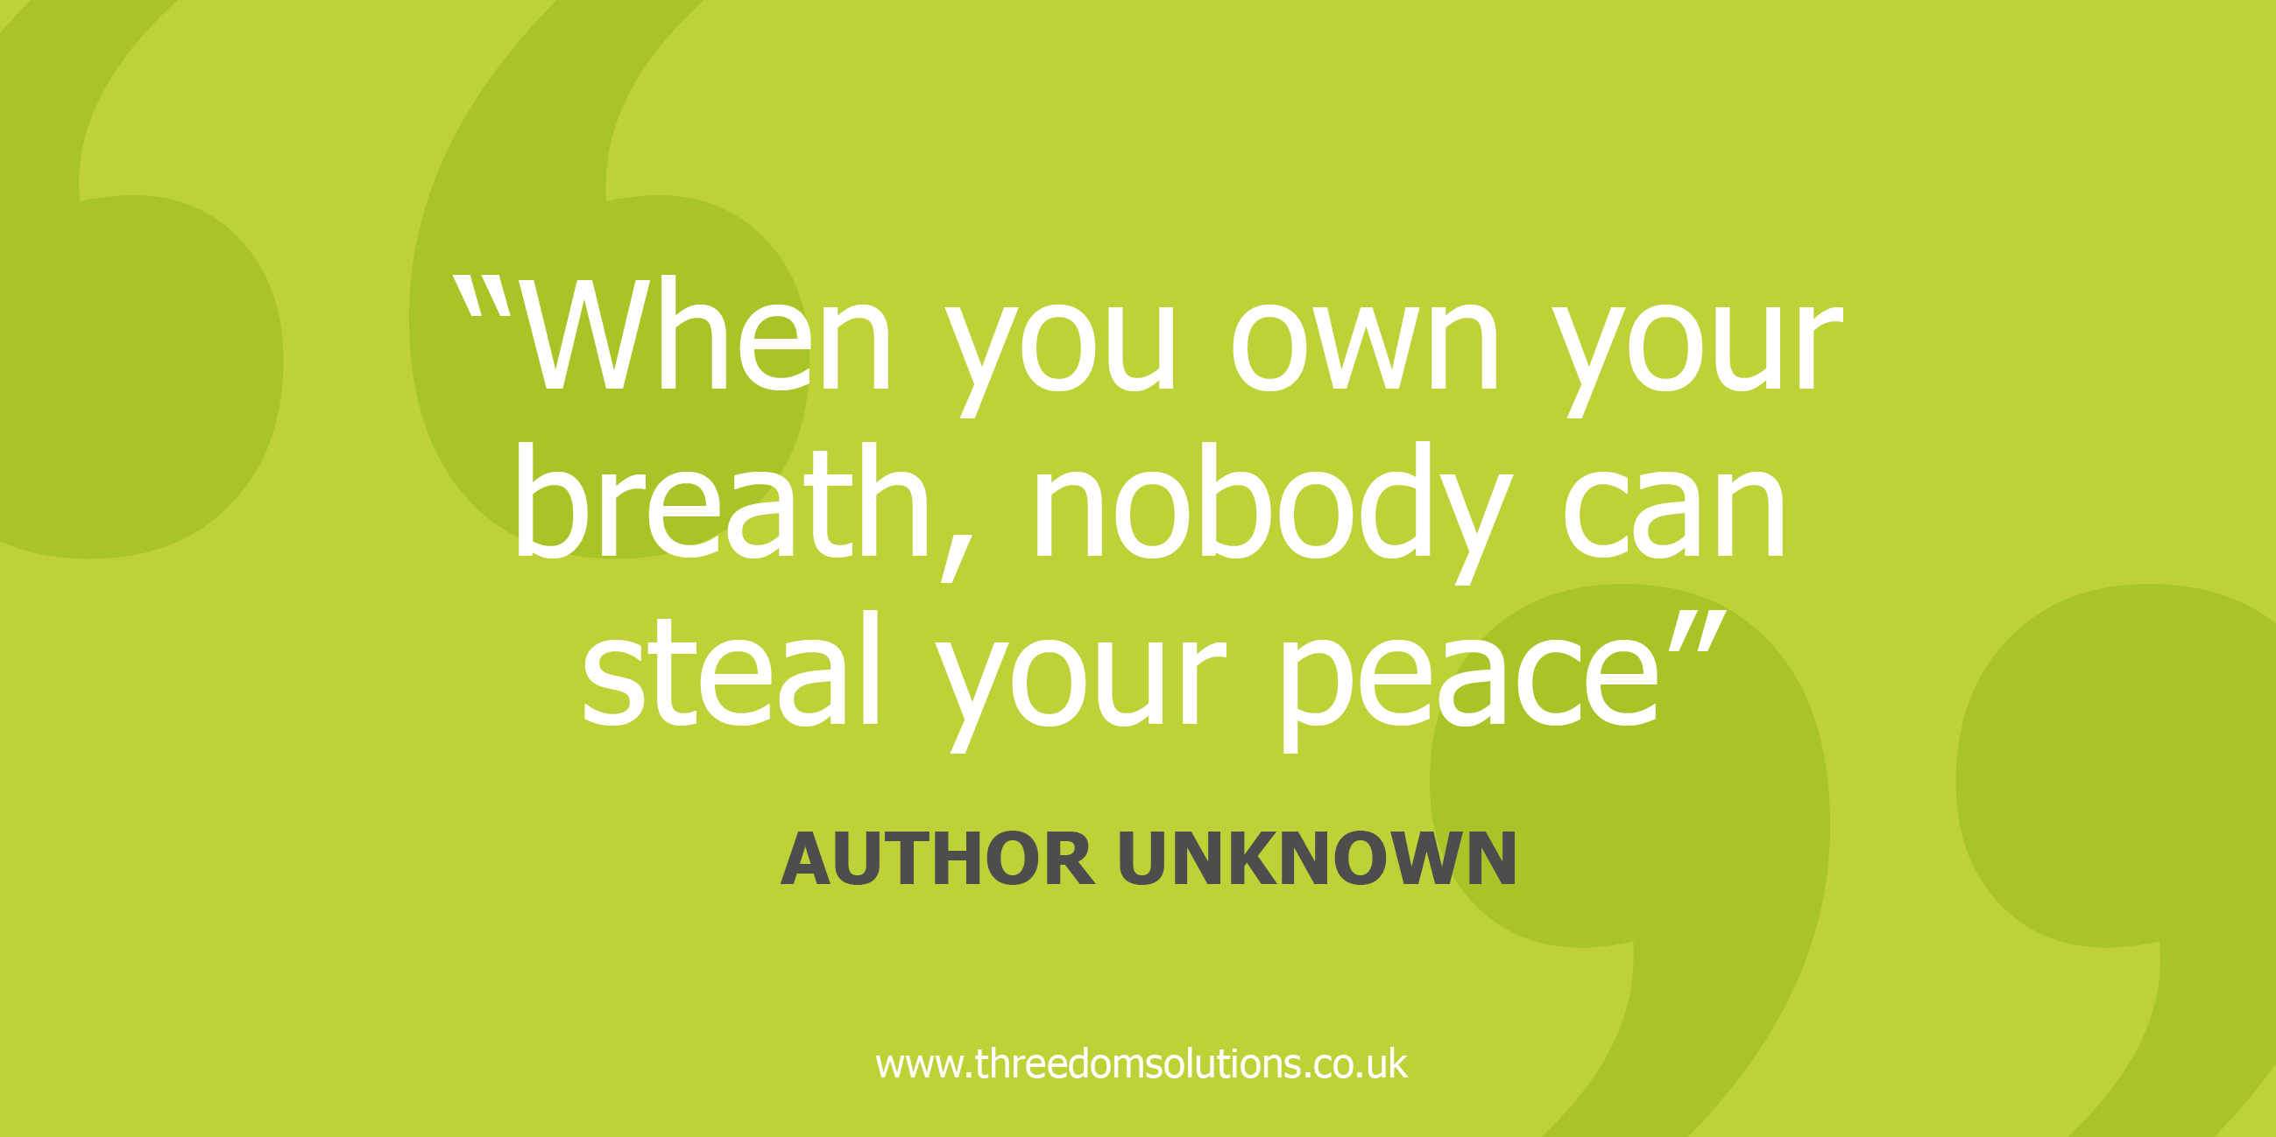
Step 5 –
Take a Deep Breath

Slide 7
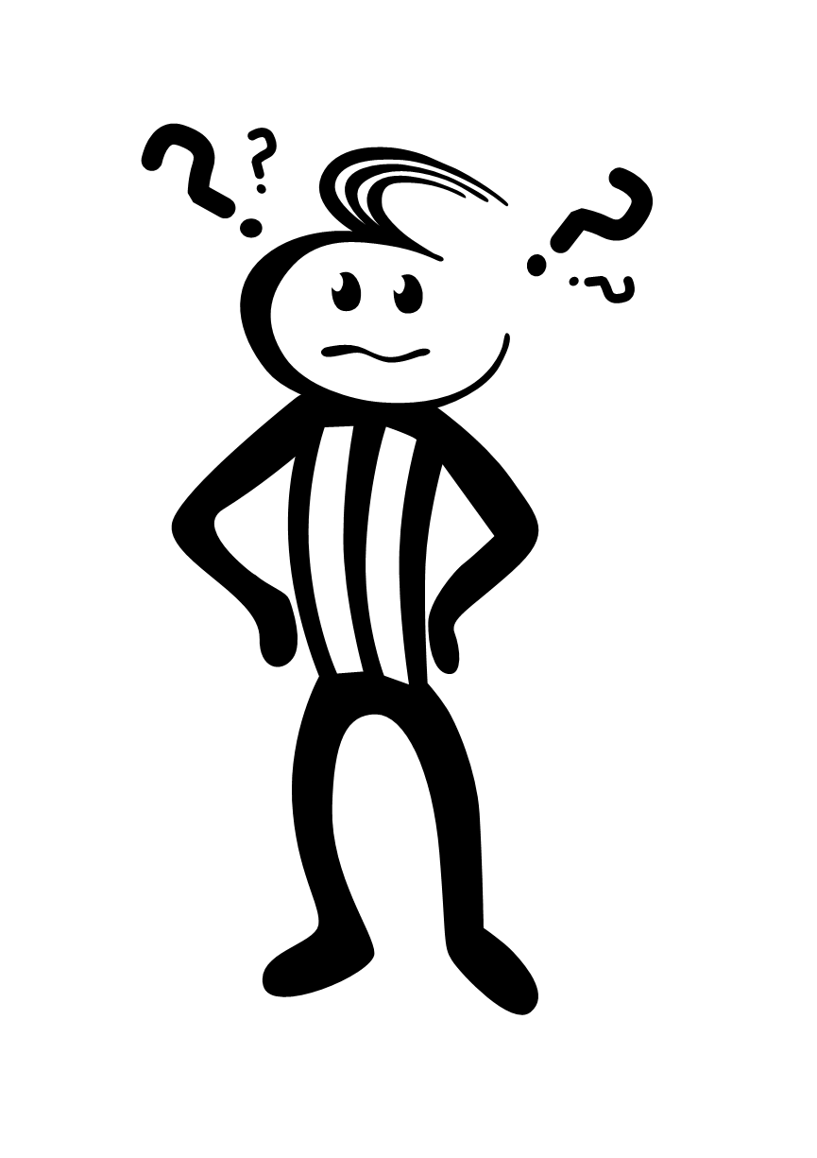
Questions
For a copy of the delegate notes please go to
www.threedomsolutions.co.uk/conference17

